Slide 1


Department of Computer Science and Engineering
Efficient Long-Sequence ECG Arrhythmia Classification Using Mamba
Architecture with Linear-Time Inference for Wearable Device
Under Guidance of
Mrs.P.Sathya, AP/CSE
Presented by 1.Boopathikannan N 2.Deenathayalan P 3.Surendhar A

Slide 2
Abstract
Electrocardiogram (ECG) analysis is essential for detecting cardiac arrhythmias in real-time healthcare systems. Traditional Transformer-based models struggle with long ECG sequences due to high computational cost and latency. This project proposes the use of the Mamba architecture, which enables linear-time inference and efficient long-sequence processing. By replacing Transformers with Mamba, the system achieves faster performance, reduced memory usage, and better scalability. This makes it highly suitable for deployment in wearable devices, ensuring accurate and real-time arrhythmia classification.

Slide 3
Problem Definition
Traditional ECG arrhythmia classification models, especially Transformer- based architectures, face high computational complexity and increased latency when processing long ECG sequences. This makes them unsuitable for real- time applications on wearable devices with limited resources. Therefore, there is a need for an efficient model that can handle long-sequence ECG data with lower computation, faster inference, and reduced memory usage while maintaining high classification accuracy.

Slide 4
Literacy Survey
Literature survey focuses on existing ECG arrhythmia classification and wearable monitoring systems. Previous studies used CNN, LSTM, and machine learning techniques for detecting abnormal heart rhythms from ECG signals. Lightweight and IoT-based wearable systems were also developed for real-time monitoring. Recent models like ECG-Mamba improved long-sequence ECG analysis. However, existing methods still face challenges such as noise sensitivity, computational complexity, and wearable deployment limitations.

Slide 5

Literacy Survey
Author & Year | Method Used | Features | Limitations | Proposed System Advantage
Jiang et al. (2025) | ECG-Mamba Model | Long-sequence ECG classification using selective state space models | Sensitive to noisy ECG signals | Efficient long-sequence ECG analysis with better wearable deployment
Qureshi et al. (2022) | CNN-Based Classification | Multiclass heartbeat classification using MIT-BIH dataset | Class imbalance affects performance | Improved robust classification with optimized deep learning
Tesfai et al. (2022) | ShuffleNet-Based CNN | Lightweight ECG classification for wearable devices | Similar arrhythmia patterns reduce accuracy | Reduced computational complexity for edge devices

Slide 6
Literacy Survey
Kim et al. (2022) | Lightweight CNN | Real-time ECG classification on low-power devices | Limited arrhythmia categories | Fast and power- efficient wearable ECG monitoring
Apu et al. (2021) | 1D CNN with Resampling | High accuracy ECG classification with Gaussian augmentation | Noise handling challenges | Improved classification accuracy with lightweight model
Sakib et al. (2021) | IoT-Based 1D CNN | Real-time arrhythmia monitoring on ultra- edge devices | Hardware resource limitations | Lightweight real-time ECG monitoring system
Banerjee et al. (2020) | CNN + LSTM | Real-time wearable ECG monitoring with cloud integration | Depends on preprocessing quality | Accurate arrhythmia detection with mobile connectivity

Slide 7
Existing System
In the existing system, ECG arrhythmia classification is mainly performed using Transformer-based deep learning models. These models provide good accuracy in analyzing ECG signals, but they require high computational power and memory when processing long ECG sequences. Due to the quadratic time complexity, the inference speed becomes slow, making them less suitable for real-time wearable healthcare devices. In addition, deploying such heavy models on edge devices is difficult because of limited battery and hardware resources.
Demerits:
High computational complexity for long ECG sequences
Slow inference speed in real-time applications
High memory and power consumption
Difficult to deploy on wearable devices
Requires powerful GPU resources for efficient processing
Reduced efficiency for continuous ECG monitoring systems

Slide 8
Proposed System
The proposed system introduces an efficient ECG arrhythmia classification model using the Mamba architecture for processing long ECG sequences. Unlike traditional Transformer-based models, the proposed approach provides linear-time inference with lower computational complexity and reduced memory usage. The system preprocesses ECG signals, extracts important features, and performs accurate arrhythmia classification in real time. The trained model is optimized using ONNX and TensorFlow Lite for deployment on wearable healthcare devices.
Merits:
Faster inference for long ECG sequences
Reduced computational and memory cost
Suitable for wearable and edge devices
Supports real-time ECG monitoring
Energy efficient and lightweight model
Optimized deployment using ONNX and TensorFlow Lite

Slide 9
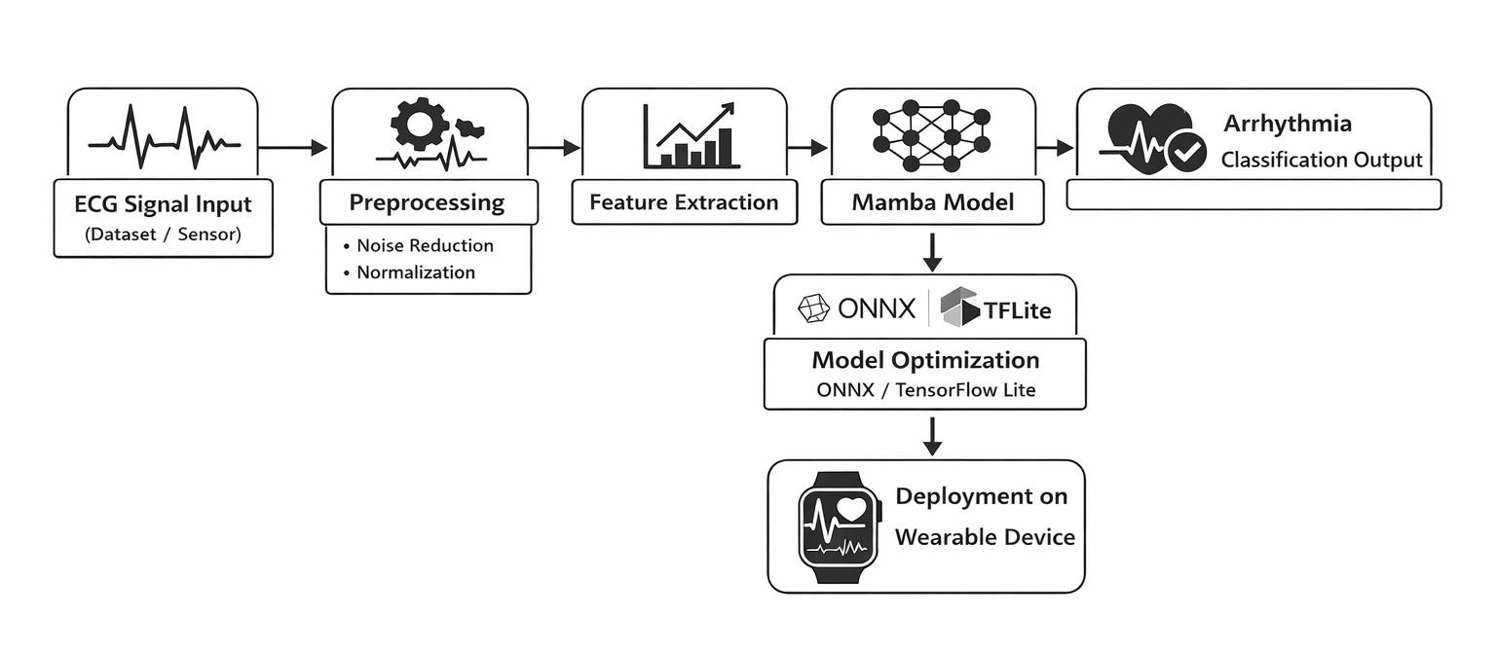
System Architecture

Slide 10
Techniques
Technologies Used:
Python – Used for model development and implementation.
PyTorch – Used for training the deep learning model.
mamba-ssm – Used to implement the Mamba architecture.
ONNX – Used for model conversion and optimization.
TensorFlow Lite – Used for deployment on wearable devices.
Techniques:
ECG Signal Preprocessing – Removing noise and normalizing ECG signals.
Feature Extraction – Extracting important patterns from ECG data.
Mamba Architecture – Efficient sequence modeling with linear-time inference.
Arrhythmia Classification – Identifying abnormal heart rhythms from ECG signals.
Model Optimization – Converting and compressing the model using ONNX and TFLite.
Wearable Deployment – Running the optimized model on edge and wearable devices.

Slide 11
Algorithm
The system uses the Mamba-based ECG classification algorithm to efficiently analyze long
ECG sequences and detect arrhythmia patterns in real time.
Steps:
Collect ECG signal data from dataset or wearable sensors.
Preprocess the ECG signals by removing noise and normalizing the data.
Feed the processed ECG signals into the Mamba architecture.
Analyze long-sequence dependencies using linear-time inference.
Classify the ECG signals into normal or arrhythmia categories.
Optimize the trained model using ONNX and TensorFlow Lite.
Deploy the optimized model on wearable devices for real-time monitoring.
Formula:
𝑇 𝑛 = 𝑂 𝑛
Where:
𝑇 𝑛 =Processing time
𝑛= Length of ECG sequence

Slide 12
Mechanism
The proposed system uses the Mamba architecture to classify ECG signals and detect arrhythmia efficiently. ECG data is collected from datasets or wearable devices and preprocessed to remove noise. Important features are extracted and given to the Mamba model for analysis. The system identifies whether the ECG signal is normal or abnormal and provides the classification result in real time. Finally, the model is optimized and deployed on wearable devices for continuous heart monitoring.
Working Mechanism:
ECG signals are collected from datasets or wearable sensors.
Noise removal and normalization are performed during preprocessing.
Important ECG features are extracted for analysis.
Mamba architecture processes long ECG sequences efficiently.
Arrhythmia classification is generated in real time.
Model is optimized using ONNX and TensorFlow Lite.
Optimized model is deployed on wearable devices.

Slide 13

Modules
ECG Data Module:
Collect ECG signals from datasets or wearable sensors
Store ECG sequence data for processing
Manage ECG input for analysis
Preprocessing Module:
Remove noise from ECG signals
Normalize ECG data
Prepare signals for feature extraction
Mamba Model Module:
Process long ECG sequences efficiently
Extract temporal dependencies from ECG signals
Perform arrhythmia classification

Slide 14
Modules
Optimization Module:
Convert model using ONNX
Optimize model with TensorFlow Lite
Reduce model size and improve inference speed
Wearable Deployment Module:
Deploy optimized model on wearable devices
Enable real-time heart monitoring
Generate arrhythmia classification results continuously

Slide 15
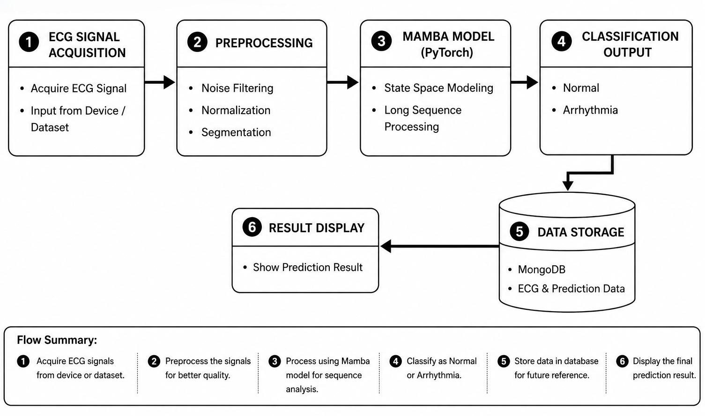
Block Diagram

Slide 16
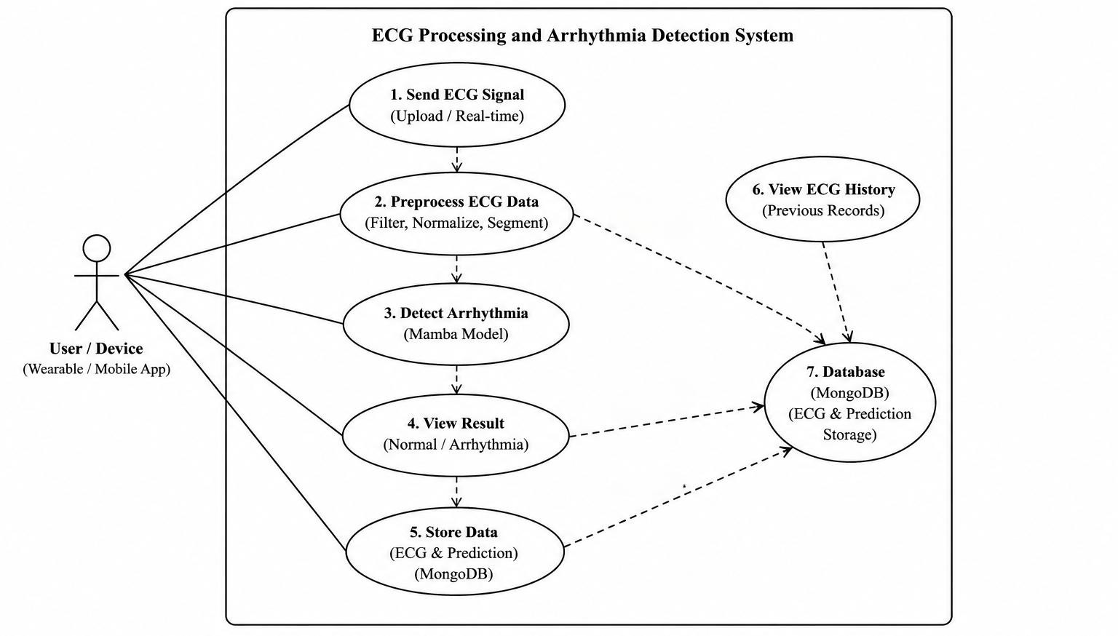
UML Diagram

Slide 17
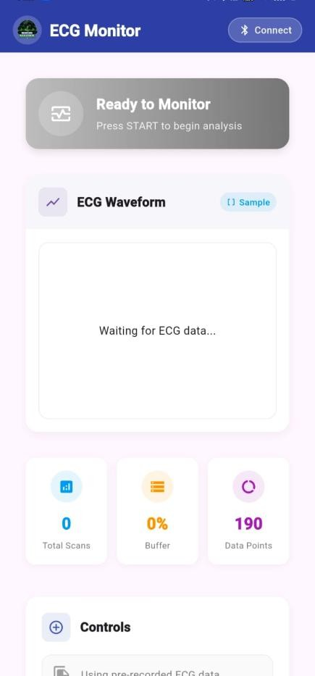
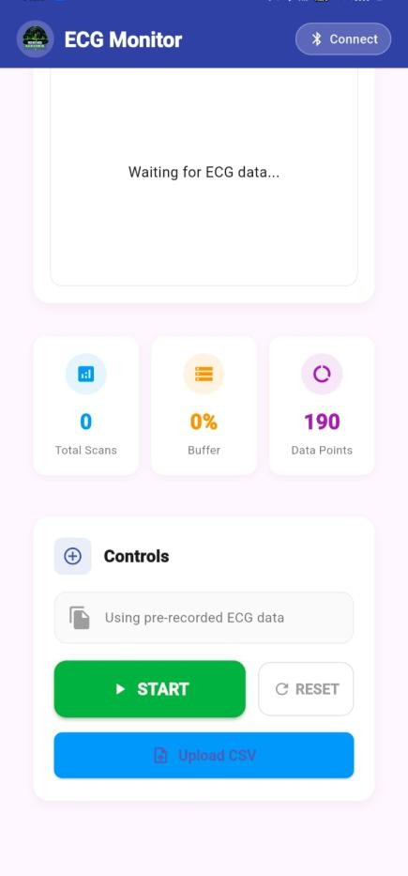
Result / Screenshot
Figure 1,2 - Home Screen

Slide 18
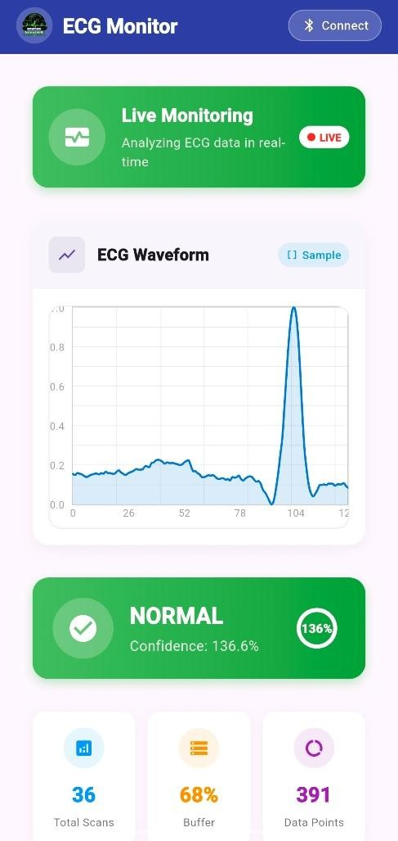
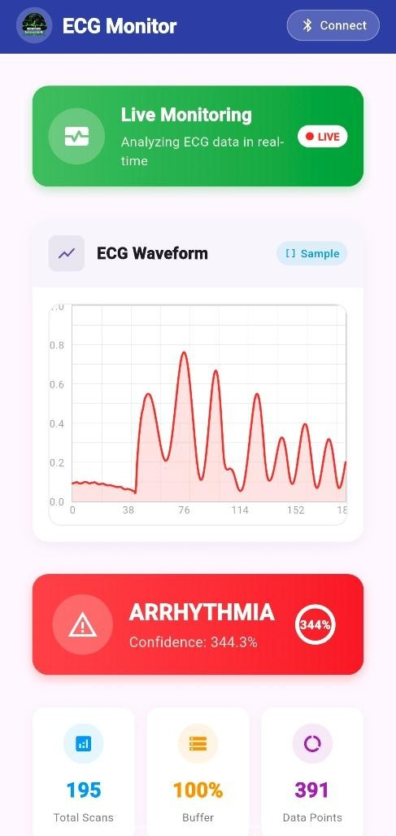
Result / Screenshot
Figure 3,4 - ECG Monitoring Screen (Normal, Arrhythmia)

Slide 19
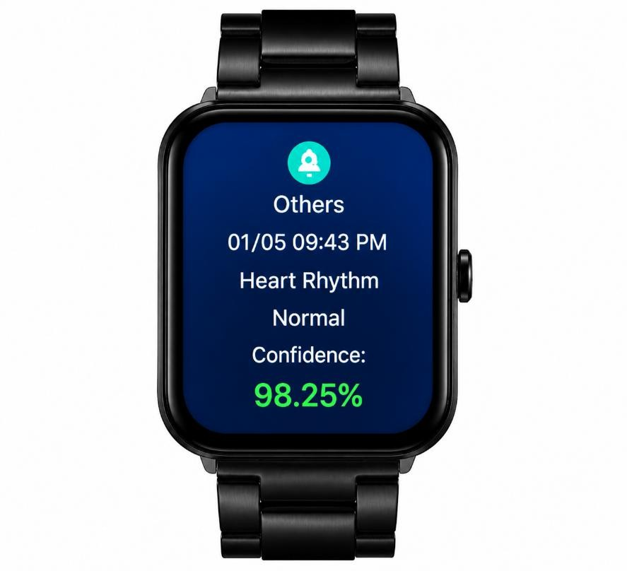
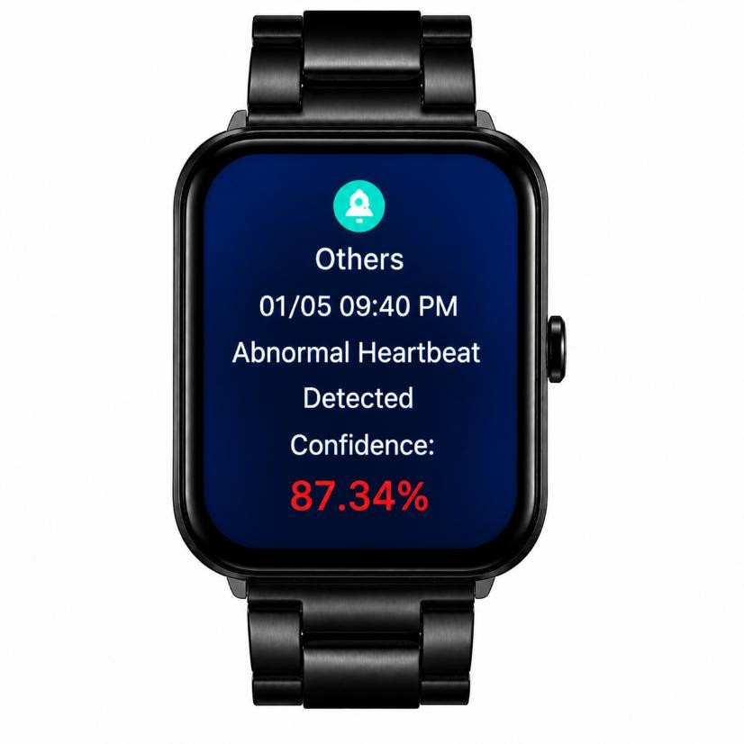
Result / Screenshot
Figure 5,6 – Wearable Output Screen (Normal, Arrhythmia)

Slide 20
Future Enhancements
Multi-Class Arrhythmia Detection
Currently, the system focuses on basic classification such as normal and arrhythmia. In future, it can be enhanced to detect multiple types of arrhythmias such as atrial fibrillation, ventricular tachycardia, and other cardiac abnormalities. This will improve diagnostic capability and provide more detailed medical insights.
AI-Based Alert and Notification System
An intelligent alert system can be implemented to notify users or doctors when abnormal ECG patterns are detected. This feature can provide instant alerts through mobile notifications, helping in emergency situations and early intervention.
Model Optimization and Edge AI Improvements
Further optimization techniques such as advanced quantization and pruning can be applied to reduce model size and improve efficiency. This will enhance performance on low-power devices and extend battery life in wearable systems.

Slide 21
Conclusion
This project presents an efficient ECG arrhythmia classification system using the Mamba architecture for processing long ECG sequences. The proposed system reduces computational complexity and provides faster inference compared to traditional Transformer-based models. By using preprocessing, feature extraction, and linear-time sequence modeling, the system accurately classifies ECG signals in real time. The model is further optimized using ONNX and TensorFlow Lite for deployment on wearable healthcare devices. Thus, the proposed approach provides a fast, lightweight, and efficient solution for continuous heart monitoring applications.

Slide 22

References
Jiang, H., Mutahira, H., Wei, S., and Muhammad, M. S. (2025) ‘ECG-Mamba: Cardiac Abnormality Classification With Non-Uniform-Mix Augmentation on 12-Lead ECGs’, IEEE Journal of Translational Engineering in Health and Medicine, Vol.13, pp.461– 469.
Qureshi, M. D. M., Mumtaz, R., de Waele, T., Peralta Camara, D., Shahid, A., De Poorter, E., and Moerman, I. (2022) ‘Multiclass Heartbeat Classification using ECG Signals and Convolutional Neural Networks’, 2022 2nd International Conference on Digital Futures and Transformative Technologies (ICoDT2), pp.1–6.
Tesfai, H., Saleh, H., Al-Qutayri, M., Mohammad, M. B., Tekeste, T., Khandoker, A., and Mohammad, B. (2022) ‘Lightweight Shufflenet Based CNN for Arrhythmia Classification’, IEEE Access, Vol.10, pp.111842–111853.

Slide 23
References
Apu, M. R. H., Akter, F., Lubna, M. F. A., Helaly, T., and Pias, T. S. (2021) ‘ECG Arrhythmia Classification Using 1D CNN Leveraging the Resampling Technique and Gaussian Mixture Model’, 2021 Joint 10th International Conference..., pp.1–8.
Sakib, S., Fouda, M. M., Fadlullah, Z. M., Nasser, N., and Alasmary, W. (2021) ‘A Proof- of-Concept of Ultra-Edge Smart IoT Sensor...’, IEEE Access, Vol.9, pp.26093–26104.
Tang, X., and Tang, W. (2021) ‘An ECG Delineation and Arrhythmia Classification
System...’, IEEE Transactions..., Vol.15, No.5, pp.1053–1063.
Alharthi, A., Almehmadi, A., and Alhazmi, S. (2020) ‘Heart Arrhythmia Detection and Monitoring using Machine Learning and ECG Sensor’, 2020 ITT, pp.1–6.

Slide 24
References
Kim, S., Chon, S., Kim, J.-K., Kim, J., Gil, Y., and Jung, S. (2022) ‘Lightweight Convolutional Neural Network for Real-Time Arrhythmia Classification on Low-Power Wearable Electrocardiograph’, 2022 44th Annual International Conference of the IEEE Engineering in Medicine & Biology Society (EMBC), pp.1915–1918.
Banerjee, S., Paul, A., Agarwal, A., and Jindal, S. K. (2020) ‘Real Time Arrhythmia Detecting Wearable using a Novel Deep Learning Model’, 2020 ICPS, pp.14–19.
Adil, A., Abid, H., Najib, N., Jillani, U., Saadeh, W., and Altaf, M. A. B. (2019) ‘Wearable ECG Measurement System for Detection of Cardiac Arrhythmia’, 2019 UCET, pp.1–4.
Rajkumar, A., Ganesan, M., and Lavanya, R. (2019) ‘Arrhythmia classification on ECG using Deep Learning’, 2019 ICACCS, pp.365–369.

Slide 25
References
Rana, A., and Kim, K. K. (2019) ‘ECG Heartbeat Classification Using a Single Layer LSTM Model’, ICCAS, pp.267–268.
Clark, N., Sandor, E., Walden, C., Ahn, I. S., and Lu, Y. (2018) ‘A wearable ECG monitoring system for real-time arrhythmia detection’, IEEE, pp.787–790.
Sannino, G., and De Pietro, G. (2018) ‘A deep learning approach for ECG-based
heartbeat classification for arrhythmia detection’, FGCS, Vol.86, pp.446–455.
Spanò, E., Di Pascoli, S., and Iannaccone, G. (2016) ‘Low-Power Wearable ECG Monitoring System for Multiple-Patient Remote Monitoring’, IEEE Sensors Journal, Vol.16, No.13, pp.5452–5461.

Slide 26

THANK YOU

